Slide 1
Let’s get to know:
LENDER EDITION
WORKIN CAP INFO SHEET

Slide 2
Prospa - Topic area 1
How to sub an app - all through the portal
Workshopping - through slack - Jess C, Michelle G and Anna s - Prospa IQ
Industries they prefer:
Hospitality, beauty & wellbeing, retail
Main points for Prospa:
They like more than 5 monthly deposits
Verbal confirmation on tax debt <$100k
They will accept PDF statements and 6 months statements
Term loan AND line of credit offer (minimum draw down for payment = $10)
Up to $150K non asset backed
3-5.5% on SBL and 3% on LOC
Run credit up front
80/20 refi policy
LOC can stack pretty easily alongside other products
6 ish DH in 6 months (not fixed)
Not too fussed on days in Neg
1.5% on remaining principal for early pay out
450 credit score COMPREHENSIVE
Non- financial/supplier defaults up to $15,000 unpaid
Financial defaults up to $10,000 unpaid
If the loan is $100K +, tax needs to be on a payment plan or no more than 60% of MTO
When ATO debt is on a payment plan, it cannot exceed 150% on MTO
Dishonours to the ATO are an automatic decline
$500K mid doc (tax portals, no caveat required)
Loans over $150K require a credit call

Slide 3
Lumi - Topic area 2
How to sub an app - through email / portal
Workshopping - through gchat, Marc, Emily
Main points for Lumi:
Minimum 400 credit score - NEGATIVE
Verbal confirmation on tax debt <$100k
No more than 13 dishonors in the last 90 days and no more than 2 financial dishonors in last 90 days
12 months statements via the banking link, PC, CF and drivers license for submission
Term loan AND line of credit offer (minimum draw down for payment = $2K or more than broker comms)
Up to $150K non asset backing
Commission is dependent on tier
You manage the full process - AM from Lumi will do pre settlement call
Run credit once they approve the deal or it declines due to poor risk grade. Servicing decliens wont hit credit
Trading time minimum 12 months (6 months if prop owner)
Do not accept agriculture
No penalties for early payout after 6 months
No facility fees on the LOC
Will PO the ATO directly
Loans $150K + need 1-1 equity
Loans above $250K require a credit call
Loans above $300K usually need a caveat (negotiable if a very strong deal)
Can refi 2 other cashflow facilities with a 5% rate loading
Generally will want to refi ATO debt if $100K +

Slide 4
Shift - Topic area 4
How to sub an app - all through the portal
Workshopping - through slack - Ramandeep Singh
Industries they prefer:
No preferred industry, happy to take on anything other than Property development/Mining, Primary Agriculture and Adult entertainment
Main points for Shift:
Products they offer: Asset Finance, Term Loan, Overdraft, Equipment finance
Don’t take tax debt into too much consideration under $50K
Minimum time in business 2 years +
They will accept 6 month statements
Minimum OD Drawdown $1000
Up to $100K non asset backed
4% on SBL and 3% on LOC (2% on any LOC lower than 23.95% APR)
Complete Product guide - https://www.shift.com.au/product-guide/
The client will have to follow the steps from shift, signing their privacy consent and uploading bank statements again.
Credit score - Comprehensive and must be over 550.
Approvals within 24 hours
Loans over $1,000,000 will require up to date financial statements and copy of ATO documents
Maximum term 5 years
Payout Policy - Remaining principal and interest on last payment
No more than 4 dishonours in the last 6 months.

Slide 5
Business Fuel - Topic area 5
Background: Business fuel was acquired by Scotpac in 2022
Things to consider:
ATO debt: For loans >$100k If ATO debt is under 100k = no problem. If ATO debt > $100k, it MUST be on a PP
Defaults: Will accept unpaid non financial defaults under 5K
Credit scores: Minimum credit score accepted is usually around 320 but 625+ is ideal NEGATIVE SCORE
Credit assessment: Loan amounts of 50K + go through two rounds of credit assessment (so the initial approval may change)
Dishonors: Only allow maximum 5% dishonors in the past 6 months and all dishonors must be made up before application.
Commission: between 3%-6%. Top ups are 4%. LOCs are 4%
Stacking: will stack with additional cash flow lenders depending on serviceability
Property: Client needs to be property backed if trading for min 6 months
MTO: cant be less than 10k
Exclusions: No industry exclusions
Will accept VISA holders if CF is more than 5 years old, trading 3 years and property backed
HIL : will refi the caps
Key Features
Product: Term loan & LOC
Term: 6-24 months for loans between 10K-100K or 6-36 months for loans between 200K-500K
Repayments: weekly (typically quote 52 weeks)
Rate: usually 38% APR for TL/ 19-29% for LOC
1 -1 serviceability with MTO
Construction not prop backed = $50K max
Submission Process
Email: PackerT@scotpac.com.au
Include the following: Business write-up, app form, ID, 12 or 6 month bank statements
Settlements: within 24-48 hours
no upfront credit checks

Slide 6
Dynamoney - Topic area 5
Key Features:
$5000 - $500,000
OD capped at $300K
Term - 12 months to 60 months
APR starting from: 14.40% - 22.95%
OD commission paid without drawing down
OD is an interest only facility
Things to consider before submitting
Min ABN age: 24 months, min GST reg 12 months
OD over 50k - Property owner, 100k for term loan
Min director score 500
OD is interest only payments (PIQ shows P&I)
More than 80% LVR means their not property owner
ATO portals over 100k and if tax not sighted they will also for it.
Servicing - 1 - 2 x last 6 months average turnover.
Credit will be run once you submit the application
Can offer an equity raise - workshop these with Jack Bushell
Do not stack with AMEX
Over $200K caveat on property is required
Point of contact:
Jack Bushell, over gchat or on the phone
Knockouts-
More than 1 non-bank cash flow lender (need to be refinanced)
Overdue ATO debt is not acceptable but manageable ATO payment plans are accepted.
Fitness, Beauty Industry & Property Development is pretty much a no go
Selling point:
Very attractive APR
OD is interest only payments on monthly basis
Exit fee is only $495-$795 + Principle.
Facility fee 1.5% for an OD
Quick approval process

Slide 7
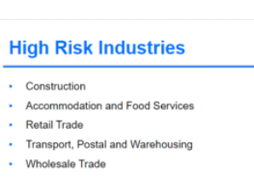
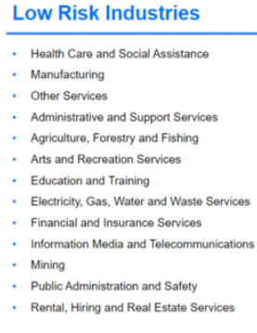
Ondeck - Topic area 7
Key Features:
Product - Term Loans
$10k - $250k amount
Coms 6% top up 4%
Can service 2-3 x their MTO
30 month terms max
23% standard but can lower to 20% on special request
Weekly repayments
90 days Topup period
Submission process:
Applications@ondeck.com to make an application.
Include bank statements, credit file, ID, application form and usual summary of business and loan purpose.
Call - 1800 676 652 if needed
Senior BDM - Joshua Edmondston jedmondston@ondeck.com.au
Key selling points:
Approval within 24hrs - 2 hours for their lightning product which is less than $100k
Min credit score 500 NEGATIVE
Love hospitality and retail
Low risk industries receive 25% increase in lending capacity (listed below)
$175K with no property
No maximum client age
Things to consider:
Won't stack on prospa
Either low doc or full doc
10k MTO minimum
No ATO docs needed for loans of below $100K
Tax debt can’t be more than 10% of annual turnover
Early payout is 75% of interest plus principle
No unpaid defaults
Can refi the caps

Slide 8
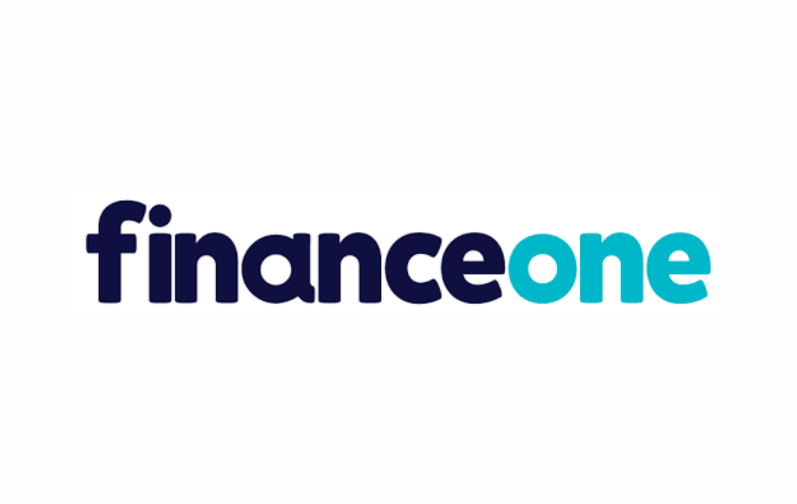
Finance One - Topic area 9
Key Features
Product: Term loan -
Platinum $5,000-$50,000
Gold $5,000 - $35,000
Term:
0-10k 12 months
10-20k 24 months
20k+ 36 months
Repayments: weekly, fort or monthly
Rate: 17.45% Platinum & 23.45% Gold SIMPLE
Payout early: N/A
Stacking: Can stack on competitor loan after 90 days
Refinance: Can replace a second cash flow lender
Things to consider:
ATO debt: needs to be manageable / on a PP
Defaults: No finance defaults in last 12 months. MAX $5,000 unpaid financial default.
Living Situation: Renting or Property owners only (Boarding / private renting DO NOT ACCEPT)
Dishonours: max 3 in 6 months
Overdrawns: max 30 days
Commission: 8% BABY + $1,100 Origination fee
Stacking: will stack with additional cash flow lenders depending on serviceability (case by case)
Security: can use vehicles as security (has to be a road worthy vehicle)
Exclusions: NDIS and rideshare / food delivery
SACC Loans: Multiple short term payday lender activity is a knockout
ABN Trading Time: 18 Months Platinum. 12 months Gold
They take an average of the last 6 months so if one month is under $5K - this is the lender to go to
Submission Process
Online Dashboard - Long Process
Include the following: Privacy Statement, bankies (majority of accounts), credit file, ID
Settlements: within 24-48 hours
Credit run when contracts are requested

Slide 9
Bizcap - Topic area 8
Key Features
Loan Size: $5k-$4M
(unsecured up to $500k)(Lines of credit up to $300k)
Short Loan Terms: 3-12 months
Minimum Turnover: Typically $12k
Repayments: Daily or Weekly
Minimum Trading Time: Typically 6 months unless cash flow is strong
No minimum credit score
Defaults and Judgements can be workable
Must be run past Meg before submitting
Submission Process
Email to deals@bizcap.com.au
Business bank statements and bizcap loan application are required
Approval is sent via email, with a final call made with the client before submission
Things to consider
Restricted Industries: Ticket Brokers and Cryptocurrency
Case By Case Assessment: Car Dealerships, Labor Hire, Finance Business, Corporate Lawyers, Adult Entertainment, Online Pharmacies, Not For Profits, Nutraceuticals, Drug Paraphernalia
Minimum 1 year trading for construction, commercial cleaning and transport
Construction and Transport MTO at least $30k
Fast Assessment as little as 3 hours
For loans over $150k you require: Tax Portals; Last Tax Return; Profit and Loss; Balance Sheet; Accounts Receivable/Payable
Customers are eligible for renewal once 60% of the loan term is reached and top-ups 20% into the loan term, assuming a good repayment history.
Can make a conditional offer without running credit
Stacking : will stack with anything
Very rubbish early payout option
If you have a long term plan with the client, maybe avoid

Slide 10

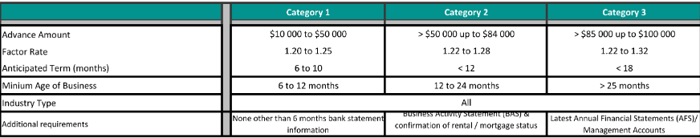
Biigga - Topic area 10
Submission/workshop:
Subbed via their portal
Workshop: Ervin Robovit
Mobile: 0497357354
Email: ervinr@biigga.au
Client to complete Biigga link https://online.biigga.au/app/start
Products offerings:
Merchant Cash Advancement - Term loan
$10k - 250k
Fixed or variable repayment structure
Repayments - Daily/weekly
Maximum term 24 months
Minimum loan size $8K
Biigga Treats
Does not need to be GST registered
Will offer 50% discount on early payout
SACC loans are not a deal breaker
PR accepted
Will accept 6 months bank statements
Will take an average of MTO (10k min)
Overdrawn/Dishonors discretionary (to an extent)
Will stack against multiple unsecured loans
No minimum credit score cut-off
New broker portal in works
Can look at 1 director being on a visa
Will look at businesses under 6 months if really strong application
Additional considerations:
Quote factor rate not APR - e.g 1.24
Typically a daily rate
Short loan terms
Deals over 100k need ATO portal
No financials defaults within last 2 years
No more than 5 dishonors in latest month - K/O
Happy to go $250K no property
Merchant Cash Advancement - Line of credit
Same parameters as MCA
Available for approvals >50k
Minimum drawdown amounts 20k
Favoured industries:
Retail/ EFTPOS businesses
Restaurants/Hospitality
Health & beauty
Auto
Tiering

Slide 11
Capify - Topic area 10
Submitting Applications: awong@capify.com.au
Contact/BDM:
Alice Wong
Key Features:
Loan Size: $5,000 - $500,000
Loan Term: 2.5 - 18 Months
MTO: Minimum $10,000
Repayments: Daily or weekly
Minimum Credit Score: 300
Minimum Trading: 6 Months
Comms: Up to 8%
Things to Consider:
Every months turnover must be >$10k.
Don’t like cafes or construction.
6 or 12 month bank statements.
Paid defaults accepted or manageable defaults on payment plan.
Option for businesses with adverse credit files.
ATO payments reviewed >$150,000.
High interest (simple interest starts from 35%) but alternative option for clients with poor credit score or poor bank statements.
Can work with businesses who can only provide 3 months worth of banking data under their Merchant Cash Advance product.
**Must run it by ISM for approval before submitting application**
Products:
Unsecured Business Loan: Fixed daily or weekly repayments (depending on cash flow). Up to $300,000.
Unsecured Business Loan (>$300,000): based on individual affordability.
Merchant Cash Advance: repaid by taking % of daily EFPOS sales. Up to $150,000.
Capify Flex: 2.5 - 7 months repayments, up to $100,000.

Slide 12

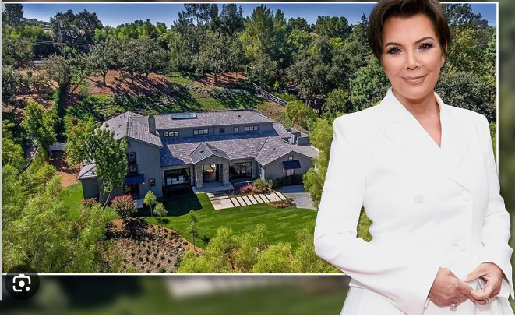
Vine - Topic area 11
BDM: Heath Fitzpatrick
Mobile: 0412805785
Email: partnerships@vinecapital.com.au
4 Products/Facilities
Interest Only Finance
Terms up to 24 months
Pay principal at the end of the year
Principle and Interest Finance
- Terms up to 36 months
- No early payout/early exit fees
Line of Credit
Revolving facility
Principal and interest facility
Terms up to 24 months
Bridging Finance
Short term loan
Terms up to 6 months
One payment at the end of the term
Criteria
Must be a homeowner
Evidence of either monthly or future income
Will consider both new and existing businesses
Business structures accepted: Sole Trader, Partnership, PTY LTD, Trust - no requirement for GST registration
If a client’s owned properties are mortgaged with the same lender - all properties will be required for security
Properties in Tasmania will incur additional legal fees and lengthy settlements
Properties in ACT are excluded
Excluded Industries: New Build Construction, single income trades
2nd mortgage behind a private lender is excluded
Depending on product, maximum LVR will be 60%-80% if in a city and 50-70% in rural.
Key Points
Maximum loan value for P+I and interest only is $500,000
Maximum loan term for principle and interest is between 3 - 5 years
Maximum LOC limit is $150,000
Interest Only term is max 2 year
Minimum loan value is $10,000
Interest Only product is max 2.5% per month
Simple Rate for P + I starts at 14.92/16.06%
Application fee for all products is a minimum of $995 up to $100,000
Brokerage set by the broker (normally 5%)
Legal fees start at $2500
All repayments for all products are weekly or fortnightly.
Documents Required
Current Rates Notice
Last 3 months of mortgage transactions
Drivers License/Passport
Current Credit File
6 months of business bank statements

Slide 13


Strive - Topic area 12
BDM: Cameron Garnham
Mobile: 0401177783
Email: cameron@strive.financial
3 Products/Facilities
Line of Credit
$25,000-$2,000,000 loan size
1 - 24 month term
Security required: first and second mortgages, PPSR over cars, trucks and boats
2.99% per month on the outstanding balance
Loan Prep Fee: from $4995
Short Term Loan
$50,000-$2,000,000 loan size
3 months to 24 months
Security required: first and second mortgages
2.49% per month - interest only
Loan Prep Fee: from $4995
Medium Term Loan
$50,000 to $2,000,000 loan size
6 months to 24 month term
Security required: first and second mortgages
Rate per month 1.99%
Loan Prep Fee: from $4995
ALL ARE INTEREST ONLY!
Criteria
Property owner
1 day ABN accepted/considered
Australia wide, no exclusions
No upfront fees
They do not do credit checks
They do not need ATO portals, BAS or bank statements
Must have an exit strategy
No restricted industries
Loan Purpose can be ATO pay outs, consolidation/refinance of working capital lenders, builders waiting for progress payments etc
What Strive Will Not Do
Loans for consumer purposes
Secure loans against the property of an applicant’s parents, unless they are actively involved in the business for over 12 months
Secure loans against the property of an applicant’s spouse (owned solely or jointly) unless they become a loan party (joint ABN)
Loans to individuals, sole traders or family partnerships. Must be PTY LTD
Loans to pensioners or people who are earning over 50% of their income through government assistance/benefits
Documents Required
Current Rates Notice
6 months of mortgage and mortgage statements/transactions
Driver’s license/Passport
No digital loan documents - customer attends a solicitors office to sign the documents/Strive can also go to meet them

Slide 14

Propell - Topic area 13
Key Features:
$10K - $250K loan amount
Up to 24 month terms
Always unsecured - will not want a caveat / prop security
Minimum time trading : 12 months
Repayments are monthly, not weekly
1.8% - 3% per month rates depending on profile (P&I)
3% establishment fee
Submission process:
Can submit via email - deals@propell.au
Key selling points:
Can refinance high interest lending
Can do FHI
Can stack with the caps also
No minimum credit score (if an issue or default, must be given context around it)
No other ongoing fees - only late fees will be applied
No restricted industries (case by case)
Only one director to sign
Things to consider:
Conditional approval given before credit checks are run
MTO has to be $10K a month
No max DH / defaults but context must be provided

Slide 15
MOULA
Main points for Moula:
Look at negative credit score : 450 minimum - ideally want 500
Can go up to $250K no prop
Can do $500K just ATO portals
If below $250K and approved for 50% of loan amount they will hit credit
Can payout the loan with no fees after 3 months
Can do a 3 year term
Fortnightly repayments
Can look into businesses trading under 12M
Minimum 12M trading
Can accept PDF AND CSV
Up to $50K will do one director guarantee
Can fund up to 70 years old - on discretion can do older
Sub through the portal - hard to workshop with
Tax portals up front for deals over $150K
No financial DH in the past 90 days
Moula Line of credit - similar to term loan
2 year availability
Revolving around
Fortnightly instalments
2% of principal drawn + interest $100,000 every fortnight
2 weeks = $2,000 + 26%/26 rate (calculated daily paid fortnight)
$150k currently , up to $500k later
Minimum drawdown
Comms upfront - 4% establishment financed
15.99 - 24.99% moula LOC
Same tier 15.99% 2M year trading
Minimum trading (2 yrs minimum trading)
Won’t convert Business loan → LOC
Check in quarterly
Can refi competitor loans
No ongoing fees
No stacking whatsoever
No PDFs

Slide 16
Finstro
Subbing App
WS with Naomi or Dan and email info template
Client will have to complete full application link for credit assessment for credit checks upfront - will also need ID & Selfie with ID
No ATO portals upto $25k - if sufficient payments sighted in banking upto $150k no portals - Construction (always needed after $25k)
No sufficient tax payment will need: Last x2 BAS, ICA Credit Scoring
Minimum company score 400, director credit scores dependent on industry - Blended score but more geared to negative
Construction minimum 600
Agriculture, Forestry and Fishing 700+
Accommodation and Food services 500+
Uber 700+
Mining 700+
Arts and Recreation 500+
Education and Training 500+
Electricity, Gas, Water and Waste Services 600+ Positives and Negative
Positive Variables: Property backed, asset ownership and tax payments in banking
Negative Variables: Gambling activity, ATM withdrawals, adverse credit history, debt collection, outstanding tax
Facility Info
LOC or debtor lends only
Can stack on caps, can refinance multiple cash flow facilities without caps as long as they service, good at refinancing caps
Maximum 3 year terms
weekly repayments
Look at Negative Score
Minimum 12 months ABN and GST registration
Minimum 12 months bank statements for assessment
Can accept PDF statements for assessment - slightly longer lead times
Up to $500k no property backing
Minimum annual turnover $75k+
ID and selfie with ID upfront
No more than 5 financial dishonors within the last 7 days, no more than 36 dishonors in the last 12 months
Overdraws do not count

Slide 17
Banjo: Pricing matrix
Key Selling Points
Min MTO: $42k (500k annually)
4% comms excl GST
Tax tolerance is 10% of annual turnover. If client’s tax is >10%, Banjo can pay it down to get it within a reasonable level.
Up to $500k Mid Doc
No property backing required up to $1m (maybe $2m)
Will only take property security if deal isn’t perfect
Can refi caps
No cooldown window if client has already taken finance recently
Can stack on shopify, square etc.
Can refi multiple facilities at once
Can offer loans to businesses <2 years if strong
Can negotiate pricing once approved (a bit)
GSA on 250k+
Flaws
No low doc process. ICA + ITA always required
Will add rate loading for ato debt, dishonours
Have some excluded industries e,g, agriculture, resi build
Credit assessors can be unnecessarily rigorous relative to other lenders
Tax conduct is very important. If tax is due to client negligence e.g. frequent late lodgements, they won’t touch it
How to submit
Via portal:
No up front credit checks
Credit hit once client is happy to proceed with their conditional approval
Can message Haifa for any questions.

